Slide 1
Well-separated pair decomposition in linear time?
Timothy M. Chan
School of Computer Science, University of Waterloo, Waterloo, Ontario N2L 3G1, Canada
Information Processing Letters 107 (2008) 138–141

Slide 2
Abstract
Given a point set in a fixed dimension, we note that a well-separated pair decomposition can be found in linear time if we assume that the ratio of the farthest pair distance to the closest pair distance is polynomially bounded. Many consequences follow; for example, we can construct spanners or solve the all-nearest-neighbors problem in linear time (under the same assumption), and we compute an approximate Euclidean minimum spanning tree in linear time (without any assumption).

Slide 3
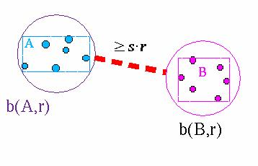
Well-separated
A, B: Two sets of points in d dimensions.
s: A parameter.
R(A): Smallest axis parallel rectangle containing all the points of A.
b(A,r): Ball centered at the center of R(A) having radius r.
A and B are well-separated if there exists a r, so that:
A⊆b(A,r)
B⊆b(B,r)
dist(b(A,r),b(B,r))≥s*r

Slide 4
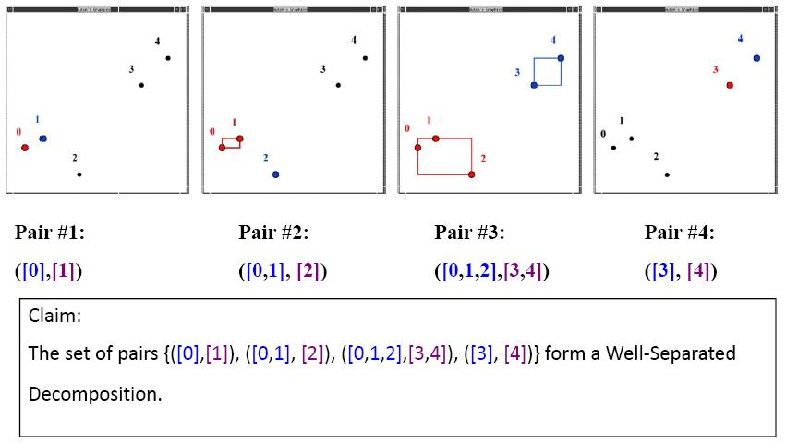
Well-separated pair decomposition(1)
Example form a paper: I/O Efficient Well‐Separated Pair Decomposition and its Applications.

Slide 5
Well-separated pair decomposition(2)
Idea: A set of points P. Represent P using a binary tree. A node represent a set made out of all the elements stroed in the leafs of the subtree.
Decompostion: A set of pairs of nodes of the tree.

Slide 6
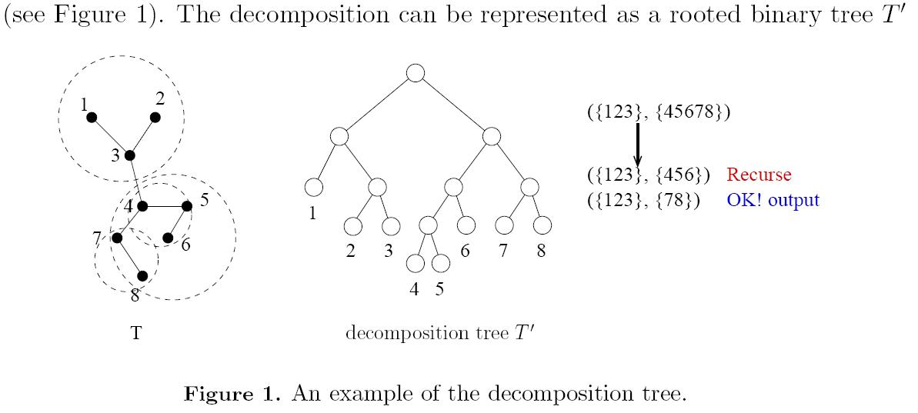
Well-separated pair decomposition(3)
Example form a paper: Well-Separated Pair Decomposition for the Unit-Disk Graph Metric and its Applications.

Slide 7
Improvement
Define the spread
The techniques we use merely involve combining known algorithms with the “shuffle-and-sort” idea.

Slide 8
Step 0: Rounding to a grid(1)
the coordinates of P are all integers in the range [0, 2^{w}) where w = ┌log(n^{c}/ε) ┐= O(logn).
ε < 1/n^{Ω (1)}

Slide 9
Step 0: Rounding to a grid(2)
The coordinates
(3,6)
6
(2,5)
(5,4)
(6,4)
4
(5,3)
(1,2)
2
(2,1)
(3,1)
0
2
4
6

Slide 10
Step 1: Sorting in shuffle order(1)
Let points with coordinates written in binary.
(1, 2) (001, 010) ; (5, 3) (101, 011).
Shuffle of (5,3) = 100111.
build a table storing the shuffles for all possible d-tuples of (logn)/b-bit coordinates.
Ex: w = 3bit, d = 2, b > d, d(logn)/b < logn, then build a table in O(n).
If b = 3, 3/3 = 1bit.
(101, 011) lookup (1,0) , (0,1), (1,1) and
concatenate 100111.

Slide 11
Step 1: Sorting in shuffle order(2)
Sort the points in increasing order of the shuffle values.
This step takes O(n) time, since for a set of n O(logn)-bit integers, radix sort with O(1) rounds runs in linear time.

Slide 12
Step 1: Sorting in shuffle order(3)
p₅
6
p₄
p₇
p₈
4
p₆
p₁
2
p₂
p₃
0
2
4
6

Slide 13
Step 2: Computing a compressed quadtree(1)
Node structure for a point quadtree.
NW
NE
2
4
1
3
p₅
SW
SE
SW
NW
SE
NE
p₄
p₇
p₈
p₆
p₆
p₁
p₁
p₄
p₅
p₇
p₈
p₂
p₃
p₂
p₃

Slide 14
Step 2: Computing a compressed quadtree(2)
Compressed quadtree is change quadtree to Cartesian tree.
Maintain the rightmost root-to-leaf path q₁, . . . , q_{k} of the tree as points are inserted in shuffle order.

Slide 15
Step 2: Computing a compressed quadtree(3)
q₀.box = R^{d}.
q₀
p₁
p₅
6
p₄
|q₀.box|
p₇
p₈
4
p₆
p₁
2
p₂
p₃
0
2
4
6

Slide 16
Step 2: Computing a compressed quadtree(4)
inserting p₂.
q₀
p₁
p₅
6
p₄
p₇
p₈
4
p₆
p₁
2
p₂
p₃
0
2
4
6

Slide 17
Step 2: Computing a compressed quadtree(5)
inserted p₂.
q₀
q₁
p₅
6
p₄
p₁
p₂
p₇
p₈
4
p₆
p₁
2
p₂
p₃
0
2
4
6

Slide 18
Step 2: Computing a compressed quadtree(6)
inserting p₃.
q₀
q₁
p₅
6
p₄
p₁
p₂
p₇
p₈
4
p₆
p₁
2
p₂
p₃
0
2
4
6

Slide 19
Step 2: Computing a compressed quadtree(7)
inserted p₃.
q₀
q₁
p₅
6
p₄
p₁
q₂
p₇
p₈
4
p₆
p₂
p₃
p₁
2
p₂
p₃
0
2
4
6

Slide 20
Step 2: Computing a compressed quadtree(6)
inserting p₄.
q₀
q₁
p₅
6
p₄
p₁
q₂
p₇
p₈
4
p₆
p₂
p₃
p₁
2
p₂
p₃
0
2
4
6

Slide 21
Step 2: Computing a compressed quadtree(7)
inserting p₄.
q₀
q₁
p₅
6
p₄
p₁
q₂
p₇
p₈
4
p₆
p₂
p₃
p₁
2
p₂
p₃
0
2
4
6

Slide 22
Step 2: Computing a compressed quadtree(7)
inserting p₄.
q₀
q₁
p₅
6
p₄
p₁
q₂
p₇
p₈
4
p₆
p₂
p₃
p₁
2
p₂
p₃
0
2
4
6

Slide 23
Step 2: Computing a compressed quadtree(8)
inserted p₄.
q₀
q₁
p₅
6
p₄
p₄
p₇
p₈
4
p₁
q₂
p₆
p₁
2
p₂
p₃
p₂
p₃
0
2
4
6

Slide 24
Step 2: Computing a compressed quadtree(9)
inserting p₅.
q₀
q₁
p₅
6
p₄
p₄
p₇
p₈
4
p₁
q₂
p₆
p₁
2
p₂
p₃
p₂
p₃
0
2
4
6

Slide 25
Step 2: Computing a compressed quadtree(10)
inserted p₅.
q₀
q₁
p₅
6
p₄
q₂
p₇
p₈
4
p₁
p₆
p₄
p₅
p₁
2
p₂
p₃
p₂
p₃
0
2
4
6

Slide 26
Step 2: Computing a compressed quadtree(11)
inserting p₆.
q₀
q₁
p₅
6
p₄
q₂
p₇
p₈
4
p₁
p₆
p₄
p₅
p₁
2
p₂
p₃
p₂
p₃
0
2
4
6

Slide 27
Step 2: Computing a compressed quadtree(12)
inserting p₆.
q₀
q₁
p₅
6
p₄
q₂
p₇
p₈
4
p₁
p₆
p₄
p₅
p₁
2
p₂
p₃
p₂
p₃
0
2
4
6

Slide 28
Step 2: Computing a compressed quadtree(14)
inserted p₆.
q₀
q₁
p₅
6
p₄
q₂
p₇
p₈
4
p₁
p₆
p₆
p₁
2
p₂
p₃
p₂
p₃
p₄
p₅
0
2
4
6

Slide 29
Step 2: Computing a compressed quadtree(15)
Inserting p₇.
q₀
q₁
p₅
6
p₄
q₂
p₇
p₈
4
p₁
p₆
p₆
p₁
2
p₂
p₃
p₂
p₃
p₄
p₅
0
2
4
6

Slide 30
Step 2: Computing a compressed quadtree(16)
Inserted p₇.
q₀
q₁
p₅
6
p₄
q₂
p₇
p₈
4
p₁
q₃
p₆
p₁
2
p₂
p₃
p₂
p₃
p₄
p₅
p₆
p₇
0
2
4
6

Slide 31
Step 2: Computing a compressed quadtree(17)
Inserting p₈.
q₀
q₁
p₅
6
p₄
q₂
p₇
p₈
4
p₁
q₃
p₆
p₁
2
p₂
p₃
p₂
p₃
p₄
p₅
p₆
p₇
0
2
4
6

Slide 32
Step 2: Computing a compressed quadtree(18)
Inserted p₈.
q₀
q₁
p₅
6
p₄
q₂
p₇
p₈
4
p₁
q₃
p₆
p₁
2
p₂
p₃
p₂
p₃
p₄
p₅
p₆
p₇
p₈
0
2
4
6

Slide 33
Step 2: Computing a compressed quadtree(19)
The running time to compute the compressed quadtree is O(n) by a simple amortization argument.
q₀
q₁
SW
NW
SE
NE
q₂
p₆
p₁
q₃
p₁
p₄
p₅
p₇
p₈
p₂
p₃
p₄
p₅
p₆
p₂
p₃
p₇
p₈

Slide 34
Step 3: Computing a WSPD(1)
Output: {([p₂], [p₃]), ([p₁], [p₂, p₃]), ([p₄], [p₅]), ([p₆], [p₇, p₈]), ([p₇], [p₈]), ([p₄, p₅], [p₆, p₇, p₈])}.
q₀
p₅
6
q₁
p₄
p₇
p₈
q₂
4
p₆
p₁
q₃
p₁
2
p₂
p₃
p₂
p₃
p₄
p₅
p₆
0
2
4
6
p₇
p₈

